Slide 1
Conversation generation
Chuwei Luo

Slide 2
Related works
Attention with Intention for a Neural Network Conversation Model
Neural Responding Machine for Short-Text Conversation
Hierarchical Neural Network Generative Models for Movie Dialogues
Stochastic Language Generation in Dialogue using Recurrent Neural Networks with Convolutional Sentence Reranking
A Neural Network Approach to Context-Sensitive Generation of Conversational Responses
A Neural Conversation Model
A Hierarchical Neural Auto-Encoder for Paragraphs and Documents

Slide 3
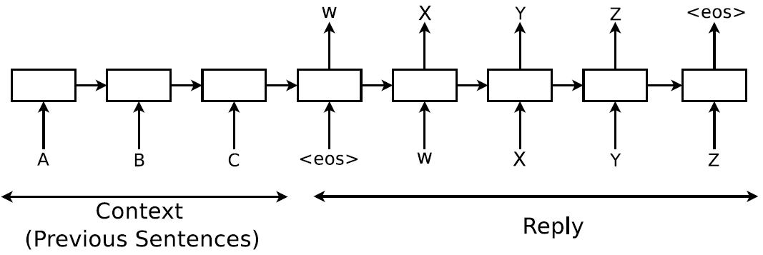
Relations among Existing Methods
All of these related works are based on a encoder-decoder neural network below:

Slide 4
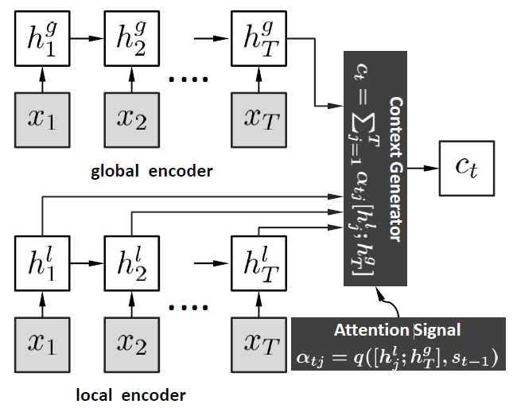
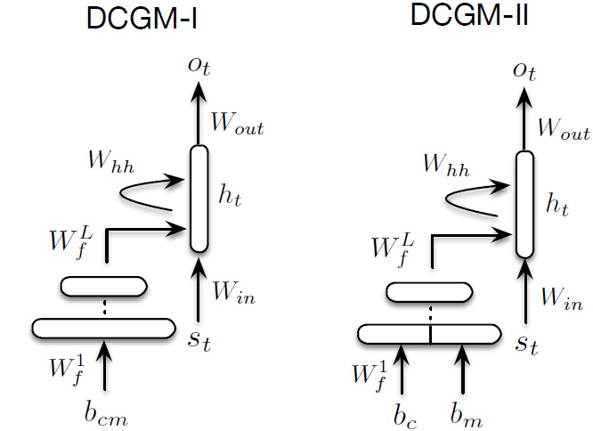
Differences among Existing Methods
All of these method try to encode the post in different ways(because they try to encode more post information in context vector). So the encoder of them are different RNN framework

Slide 5
Question 1
Evaluation is difficult:
Human evaluation(almost no rules, just evaluated by people’s linguistic feel)
How to generate a proper response which can be evaluated by people’s feel as a good response ?

Slide 6
Question 2
Sequence-to-sequence neural network models for generation of conversational responses tend to generate safe, commonplace responses (e.g., I don’t know) regardless of the input. And what we want is producing more interesting, and appropriate responses.

Slide 7
Question 3
In neural conversation model
Currently these methods do not care about error propagation
The error propagation makes the keyword we want in the response replaced by another word. So once a decoder returns a wrong response word, it may finally generate a response that not appropriate to the post.
Vocabulary list
encoder
Context vector
h_{z}1
h_{z}2
h_{z}3
h_{z}3
Word 1
Word 2
…
…
…
…
Word n
你喜欢什么水果？
x₁
x₂
x₃
x₃
我
喜欢
打
篮球
吃
苹果
米饭

Slide 8
Solution
Unfortunately, there are no grammars of paragraph structure, no general linguistic theories of the parts of speech of discourse and inference. But people do assemble sentences into well-structured multi-sentence texts in a principled way. What principles do they use? How do the principles relate to inferences? What basic elements govern discourse structure? And for our generation evaluation, how do people decide the response which our model generates is appropriate?

Slide 9
Solution
The key insight for solving these questions is the notion of text coherence. Following [Mann & Thompson 88] we define coherence as follows:
A discourse is coherent if the hearer knows the communicative role of each portion of it; that is, if the hearer knows how the speaker intends each clause to relate to each other clause.
In other words, a discourse is coherent and will succeed only if it is properly structured if :
segments properly reflect communicative intentions
interrelationships among segments are properly expressed

Slide 10
Solution
Any person or system producing discourse must therefore confront the problem of discourse structure, which can be posed as a set of questions:
Since we are interested in computer-based generation: By what process can a computer plan an effective or a well communication? (Encoder-decoder neural network)
Since coherence is very important: how can we ensure our model/system have the ability to make the generating response coherent?
Since generating a well communication succeeds only if the “hearer” gives a good response: How can we guide the “hearer's” generating process?

Slide 11
Discourse focus (Focus of attention in discourse)
Within the context of a discourse or conversation, one of the discourse entities serves as the focus(focus of attention).
Defined by Dik(1997: 326):
Information which is relatively the most important or salient in the given communicative setting.
The notion is more formally put by Erteschik-Shir(1997:11) as follows:
The FOCUS of a sentence S = the (intension of a) constituent c of S which the speaker intends to direct the attention of his/her hearers to, by uttering S.
Usually the object, property, or salient relation

Slide 12
Solution
Since the focus is the most important constituent in a sentence. If we generate the focus of the response correctly, we can make our generating response’s text coherent. And then our model/system can be guided by this focus to generate the “well” response.
Existing method (Using FOCUS to generate discourse) :
Hovy E H. Automated discourse generation using discourse structure relations[J]. Artificial intelligence, 1993, 63(1): 341-385.
Maybury M T. Using Discourse Focus, Temporal Focus, and Spatial to Generate Multisentential Text[J]. 1990.
Grosz B J, Sidner C L. Attention, intentions, and the structure of discourse[J]. Computational linguistics, 1986, 12(3): 175-204.
McCoy K F, Cheng J. Focus of attention: Constraining what can be said next[M]//Natural language generation in artificial intelligence and computational linguistics. Springer US, 1991: 103-124.
Holmes-Higgin P. Text generation—using discourse strategies and focus constraints to generate natural language text by Kathleen R. McKeown, Cambridge University Press, 1992, pp 246,£ 13.95, ISBN 0-521-43802-0[J]. The Knowledge Engineering Review, 1994, 9(04): 421-422.
McKeown K R. Discourse strategies for generating natural-language text[J]. Artificial Intelligence, 1985, 27(1): 1-41.
Hovy E H. Automated discourse generation using discourse structure relations[J]. Artificial intelligence, 1993, 63(1): 341-385.
Grosz B J. The representation and use of focus in a system for understanding dialogs[C]//IJCAI. 1977, 67: 76.
…

Slide 13
Solution to Question 3
Since we judge the response generated according to text coherence, the focus of response should be appropriate. So if we know the position of the focus of sentence, we could check it. To do so, we can alleviate the issue of the error propagation. But in RNN, we can not decide when we should make a check during decoding.

Slide 14

Our Model
POST x = (有事, 没事, 常, 回家, 看看) = (x₁, x₂, x₃, x₄, x₅)
Response y = (马上, 就, 可以, 回家, 吃, 妈妈, 做的, 饭, 了) = (y₁, y₂, y₃, y₄, y₅, y₆, y₇, y₈, y₉)
Suppose “回家” is the FOCUS.

Slide 15
Our Model
马上
就
可以
回家
回家
吃
妈妈
做的
饭
了
y₁
y₂
y₃
y₄
y₄
y₅
y₆
y₇
y₈
y₉
h_{d1}4
h_{d1}3
h_{d1}2
h_{d}1
h_{d}1
h_{d2}2
h_{d2}3
h_{d2}4
h_{d2}5
h_{d2}6
Context vector
Attention layer
h1
h2
h3
h4
h5
x₁
x₂
x₃
x₄
x₅
有事
没事
常
回家
看看

Slide 16
Advantages of the model
We generate the response by generating the FOCUS first and this step can almost ensure the response’s text coherent. And then guiding our decoder RNN with the FOCUS to generate the whole sentence.
The attention model here is very appropriate to the FOCUS. And by doing this, we take the input into account. The model can produce more interesting, and appropriate responses.
Our model knows where the FOCUS(the most important constituent) is so it has the ability to check whether the FOCUS is coherent to post or not. This step can alleviate the issue of error propagation of RNN decoder.

Slide 17
Experiment
Data
Short-text-conversation dataset
One post have many responses
For convenience:
Focus space: treat the post and its responses as an article, get top N keywords from the “article” as the focus.
If the word in a sentence in the Focus space, and has maximum number of occurrences, treat the word as FOCUS. If no word appears in the focus space, do not use the response.

Slide 18
Thanks

